Slide 1
Central Online Grading System
COGS
Dec15-21
dec1521.sd.ece.iastate.edu
Notes:
Introduce ourselves

Slide 2
Problem Statement
Cpr E 185 has weekly programming practices
Blackboard is a frustrating interface
Cannot display .c or .txt files
Downloading, compiling, and running student code is tedious

Slide 3
Solution Overview
The goal of COGS: Streamline the grading process
Features
Intuitive Assignment creation
Easy student submission
Secure compiler
Automatic testing
Cheating detection
Streamlined grading
Blackboard Integration
Notes:
Our solution to this problem is COGS. COGS is an all encompassing web based solution that aims to streamline the grading process. It will contain features that will allow for optimized grading, automatic testing, cheating detection, and grade storage. We will discuss all of these in more detail in the following slides.

Slide 4
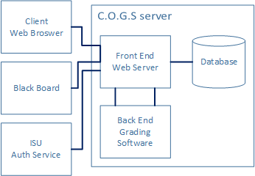
Conceptual Sketch

Slide 5
Resources and Risks
Resources:
Virtual Machine Server
Risks:
Security
Hosting student data
Blackboard interfacing
Notes:
Constraints and Such by Zach Lones
For resources, we will require a Virtual Machine on the ISU Network. This would allow the system to be built from scratch from a creation script.
As for risks, we’re taking measures to prevent any security risks on the system. Because we’re running Student code, some malicious code could hurt the system, so we’ve taken steps to not let that happen.
Because we’re hosting Student data and grades, we need to remain aware of ISU’s policies related to the handling of that data.
Finally, because Blackboard is garbo, but we’ve promised some integration, we need to find a way to connect our system to it.

Slide 6
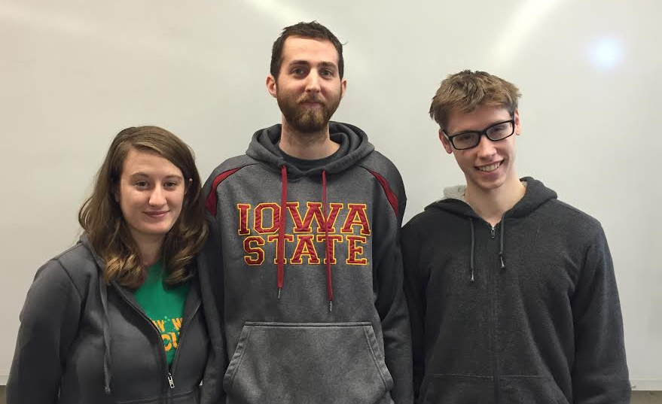
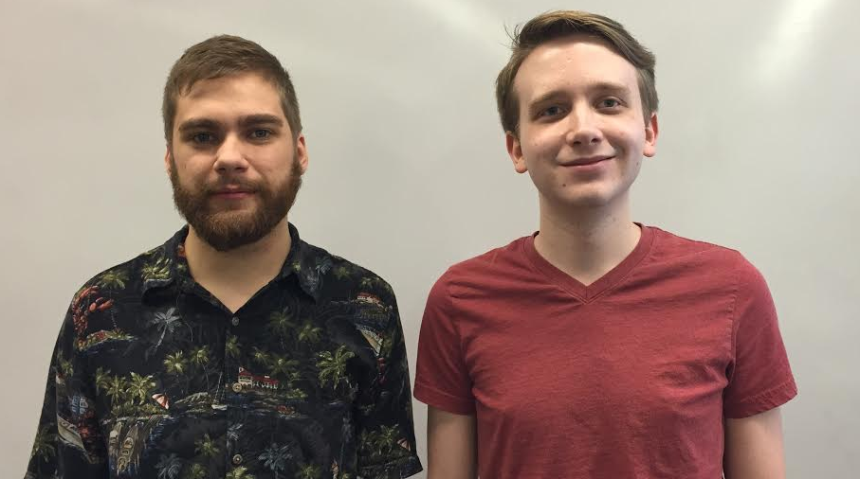
Project Divisions
Web Team
Zend Framework
User Interface
Blackboard Interfacing
Database Communication
Members
Forrest Scott
Katie Widen
Daniel McDonough
Systems Team
Grader
Authentication/Security
Cheating Detection
Members
Zachary Lones
Daniel Riechers

Slide 7
Detailed Design - Front End
Zend Framework
Open Source
Object Oriented
MVC structure
Modular
Secure
High Performance

Slide 8
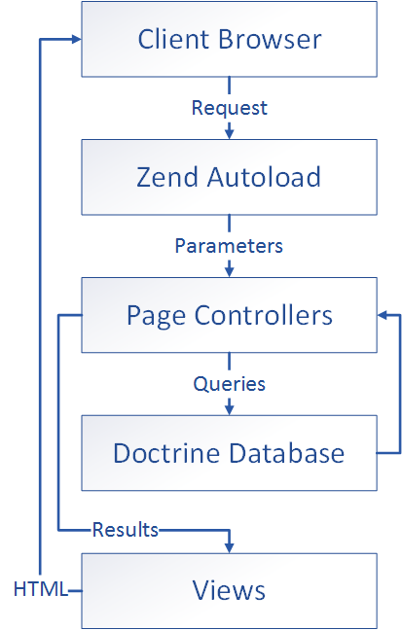
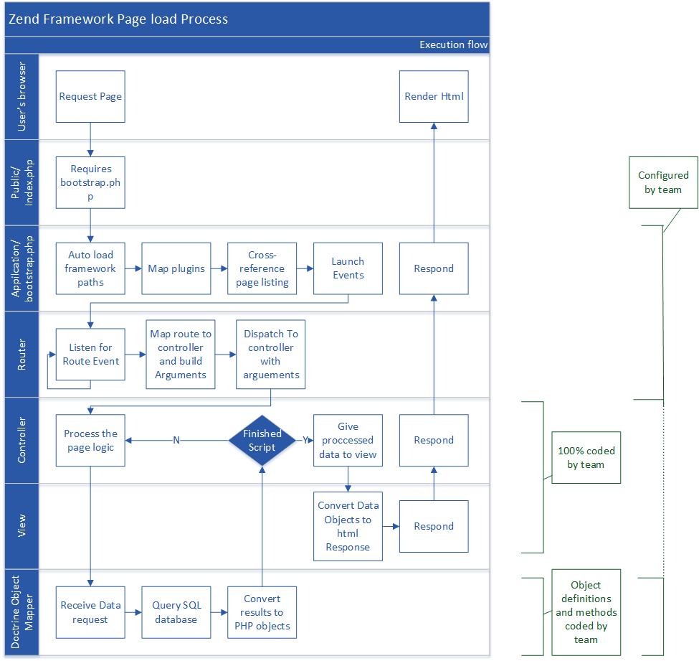
Detailed Design - Front End
Complex Diagram
Simplified

Slide 9
Detailed Design - Front End
Zend Autoloader
Resource Loading
Object Building
Security
Configurable Routes

Slide 10
Detailed Design - Front End
Zend Controllers
M-V-C
The “Brains” of the Front End
Communicates with Back End
Forms, Plugins, Modules

Slide 11
Detailed Design - Front End
Doctrine 2 Database
M-V-C
MySQL
Object Oriented
Lazy loading
Custom Macros
Auto Hydration

Slide 12
Detailed Design - Front End
ZendFramework Views
M-V-C
PHP + HTML
Final Stage

Slide 13
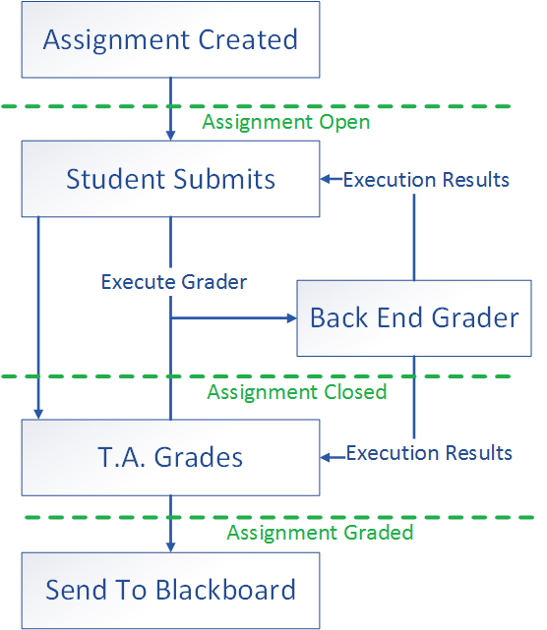
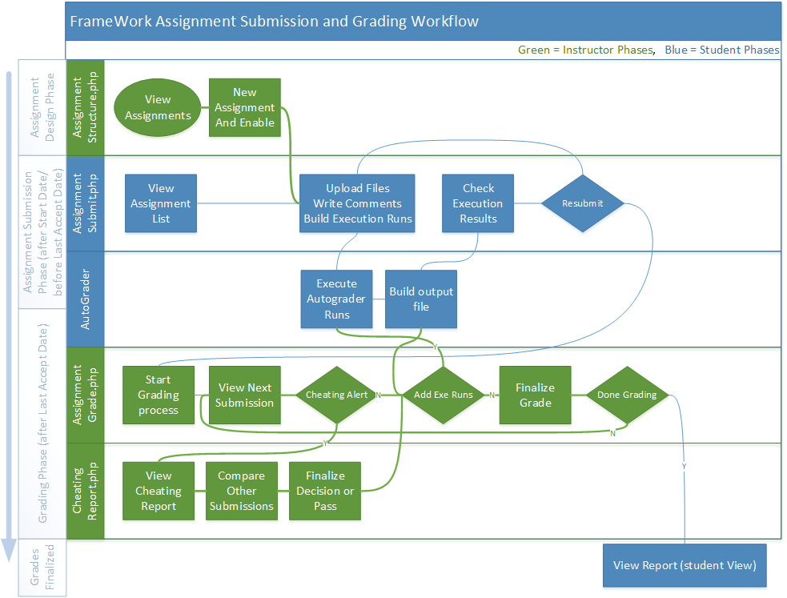
Detailed Design - Grading
Simplified
Complex Diagram

Slide 14
Detailed Design - Grading
Student Submits
Custom execution inputs
Back end runs
Returns errors, outputs
Last submission is used

Slide 15
Detailed Design - Grading
T.A. Grading
Streamlined grading pages
Can create new execution
Alerts when cheating detected
Notes viewable by students
Upload to Blackboard via .csv file

Slide 16
Detailed Design - Security
Prevents stalled code using timers
All student code is run in a chrooted environment
Minimal filesystem
The system uses a Mandatory Access Control policy
Transparent to administrators

Slide 17
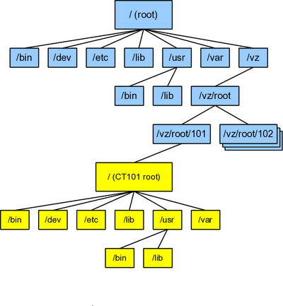
Detailed Design - Chroot Filesystem
Adds level of system protection
Prevents student software from interacting with the filesystem.
Changing system configuration
Installing Malware
Gathering system information

Slide 18
Mandatory Access Control (MAC)
Forces permissions
Permissions limit user access to
Files
System Calls
Devices
Shared Resources
Network
We used SELinux for MAC
SELinux is an implementation of MAC by NSA

Slide 19
Detailed Design - SELinux
Policy is transparent to administrators.
Policy should not limit administration
Policy should not need modification
Policy is extra strict on student code executions.
System calls are whitelisted
SELinux Aware Firewall
Further limits network traffic

Slide 20
Front End Requirements
Administration (Add/Remove/Edit)
Classes
Instructors
Instructors (Add/Remove/Edit)
Assignments
Students
Submission Scores
Students
Upload Assignments
Check Results
Notes:
For more detailed requirements, please refer to our design doc

Slide 21
Back End: Grader Requirements
Preliminary Report
Shows compiler errors and warnings
Includes students custom inputs and resulting outputs
Shows results of unit tests
Final Report
Everything in Preliminary Report of final submission
Include additional tests and static analysis
Returned to student after Instructor has written grades and comments
Notes:
Requirements by Daniel Riechers

Slide 22
Back End: Cheating Detector Requirements
Cheating Report
Displays code similarities across submissions
Generates a cheating confidence score
Run cheating detection algorithm on students’ final submissions
Report is viewable by Instructors if cheating is detected.

Slide 23
Security Requirements
Use Mandatory Access Control to encapsulate student code.
Use a chroot environment to encapsulate student code.
Use a firewall that restricts unauthorized network communication
The student code will be allowed to execute the following system calls:
read ○ close
write ○ open
create

Slide 24
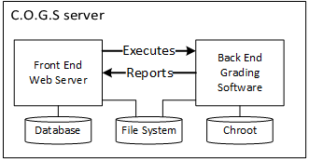
Integration Requirements
Web server executes the grader
Grader returns its output to the web server via stdout
Web server stores grader results in database
Blackboard integration is handled manually via .csv

Slide 25
Non-functional Requirements
Streamline the process: make grading as intuitive as possible
Mandatory Access Control will be transparent to system administrators
All external dependencies will be verified to be secure and reliable
Shibboleth
Zend plugins
Runtime libraries
Maintainable
Extreme care taken when handling student information

Slide 26
Test Plan - Front End
Manual testing for individual components
Alpha testing using a small group of students and single instructor
Beta testing using a larger volume of students and multiple instructors

Slide 27
Test Plan - Backend
All backend modules (Grader, Cheating detection) are unit tested with Google Tests.
The SELinux Policy and security encapsulation are tested manually.

Slide 28
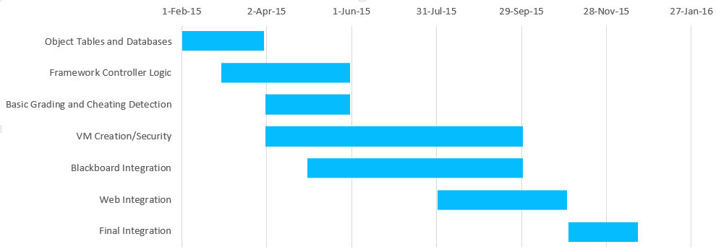
Current status and Future Plans
Current Status

Slide 29
Questions?

